Slide 1
Resting Alpha state activity related to SNR 50
Methods
Participants (n=38): Mean age=65 (31-78). Mild to moderate hearing loss. Hearing aid users
Measures:
Alpha power (7.5-12.5 hz) in occipital brain regions
Signal to noise ratio (SNR) threshold at 50% correct (SNR-50)
Subjective measures of hearing loss
EEG
64-channel EEG monitored using Neuroscan
Reference – Cz. Ground – Afz
Eyes alternate between open and closed conditions lasting 2 minutes each. 3 trials. 12 minutes total
EEG data analyzed in Matlab using Fieldtrip
Data bandpass filtered between .5 and 50 hz
Independent component analysis removed components related to signal, eye movement, and cardiac noise
FFT analysis run using Hanning window
Alpha power calculated between 7.5 and 12.5 hz
Alpha peak selected between 7.5 and 12.5 hz. Peak +/- 2hz are selected as a 4 hz window.
Alpha peak power is calculated around 4 hz window

Slide 2
SNR study
MoCA – Montreal Cognitive Assessment
Test Box Measures
ANSI
DIR (SNR = 3)
DNR (AC 70 dB)
ANL (Unaided) – Acceptable Noise Level
HINT/PPT (Unaided)- Hearing In Noise Test
Real Ear Measures
MLST & Listening Effort Estimates – Multimodal Lexical Sentence Test
APHAB – Abbreviated Profile of Hearing Aid Benefit
HHIE/HHIA – Hearing Handicap Inventory for Elderly
DOSO – Development of the Device-Oriented Subjective Outcome SADL – Satisfaction with Amplification in Daily Life IOI-HA – International Outcome Inventory for Hearing Aids
SSQ12 – Speech Spatial and Qualities of Hearing
ALDQ
LESQ
NEO-FFI
Reading Span
Word Span

Slide 3
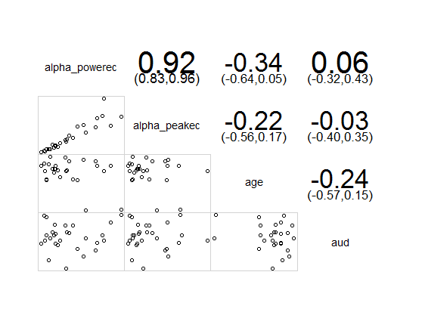
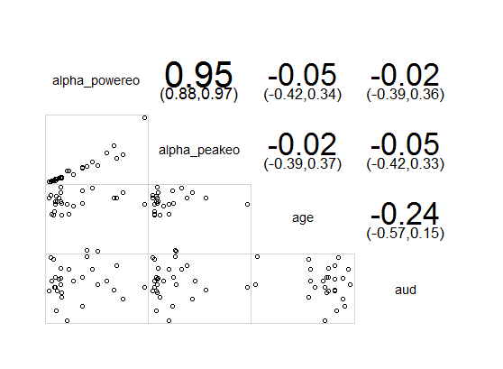
Alphapower vs age and audibility
Eyes Closed
Eyes Open

Slide 4
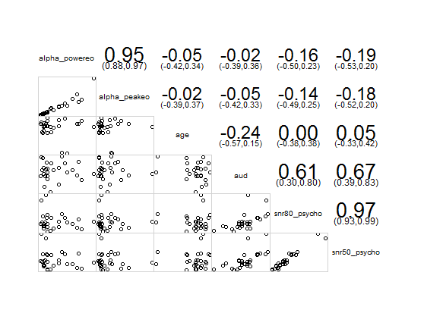

Alpha power vs SNR 50 and SNR 80

Slide 5
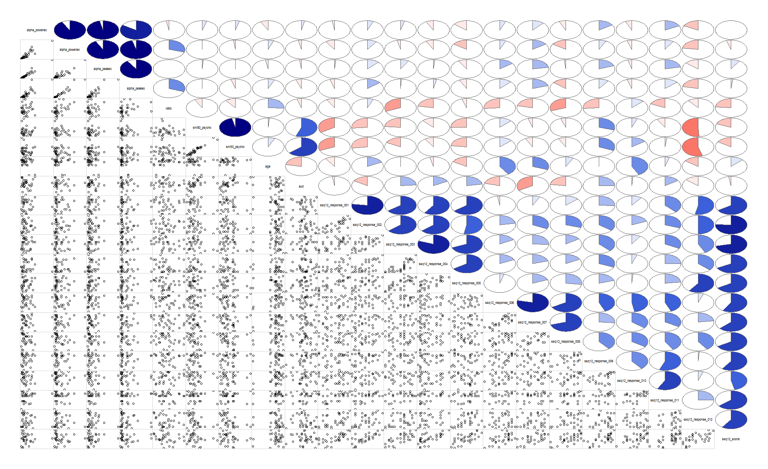
SSQ 12: Individual Responses

Slide 6
lm(formula = alpha_power_peak_ratio ~ ssq12_response_001 + ssq12_response_002 + ssq12_response_003 + ssq12_response_005 + ssq12_response_008 + ssq12_response_009 + ssq12_response_010, data = all_data)
Residuals:
Min 1Q Median 3Q Max
-0.22038 -0.12610 0.00370 0.07723 0.32024
Coefficients:
Estimate Std. Error t value Pr(>|t|)
(Intercept) 0.930444 0.133521 6.969 5.39e-07 ***
ssq12_response_001 -0.004155 0.002404 -1.728 0.09792 .
ssq12_response_002 0.006839 0.002116 3.232 0.00383 **
ssq12_response_003 -0.006637 0.002222 -2.987 0.00680 **
ssq12_response_005 0.003906 0.001925 2.029 0.05472 .
ssq12_response_008 -0.004860 0.001392 -3.492 0.00207 **
ssq12_response_009 -0.001838 0.001359 -1.352 0.18996
ssq12_response_010 0.002621 0.001401 1.870 0.07481 .
---
Signif. codes: 0 ‘***’ 0.001 ‘**’ 0.01 ‘*’ 0.05 ‘.’ 0.1 ‘ ’ 1 Residual standard error: 0.1652 on 22 degrees of freedom
(3 observations deleted due to missingness) Multiple R-squared: 0.5721, Adjusted R-squared: 0.436
F-statistic: 4.202 on 7 and 22 DF, p-value: 0.004438
Speech in Noise [1,2,3,4,5]
8) Can you tell from the sound whether a bus or a truck is coming towards you or going away?
10) When you listen to music, can you make out which instruments are playing?

Slide 7
lm(formula = alpha_power_peak_ratio ~ SSQ2, data = all_data)
Residuals:
Min 1Q Median 3Q Max
-0.39029 -0.13188 0.01583 0.12879 0.49161
Coefficients:
Estimate Std. Error t value Pr(>|t|)
(Intercept) 0.761527 0.108139 7.042 3.95e-08 ***
SSQ2 -0.003667 0.001652 -2.220 0.0332 *
--- Signif. codes: 0 ‘***’ 0.001 ‘**’ 0.01 ‘*’ 0.05 ‘.’ 0.1 ‘ ’ 1 Residual standard error: 0.2153 on 34 degrees of freedom Multiple R-squared: 0.1266, Adjusted R-squared: 0.1009 F-statistic: 4.93 on 1 and 34 DF, p-value: 0.03316

Slide 8
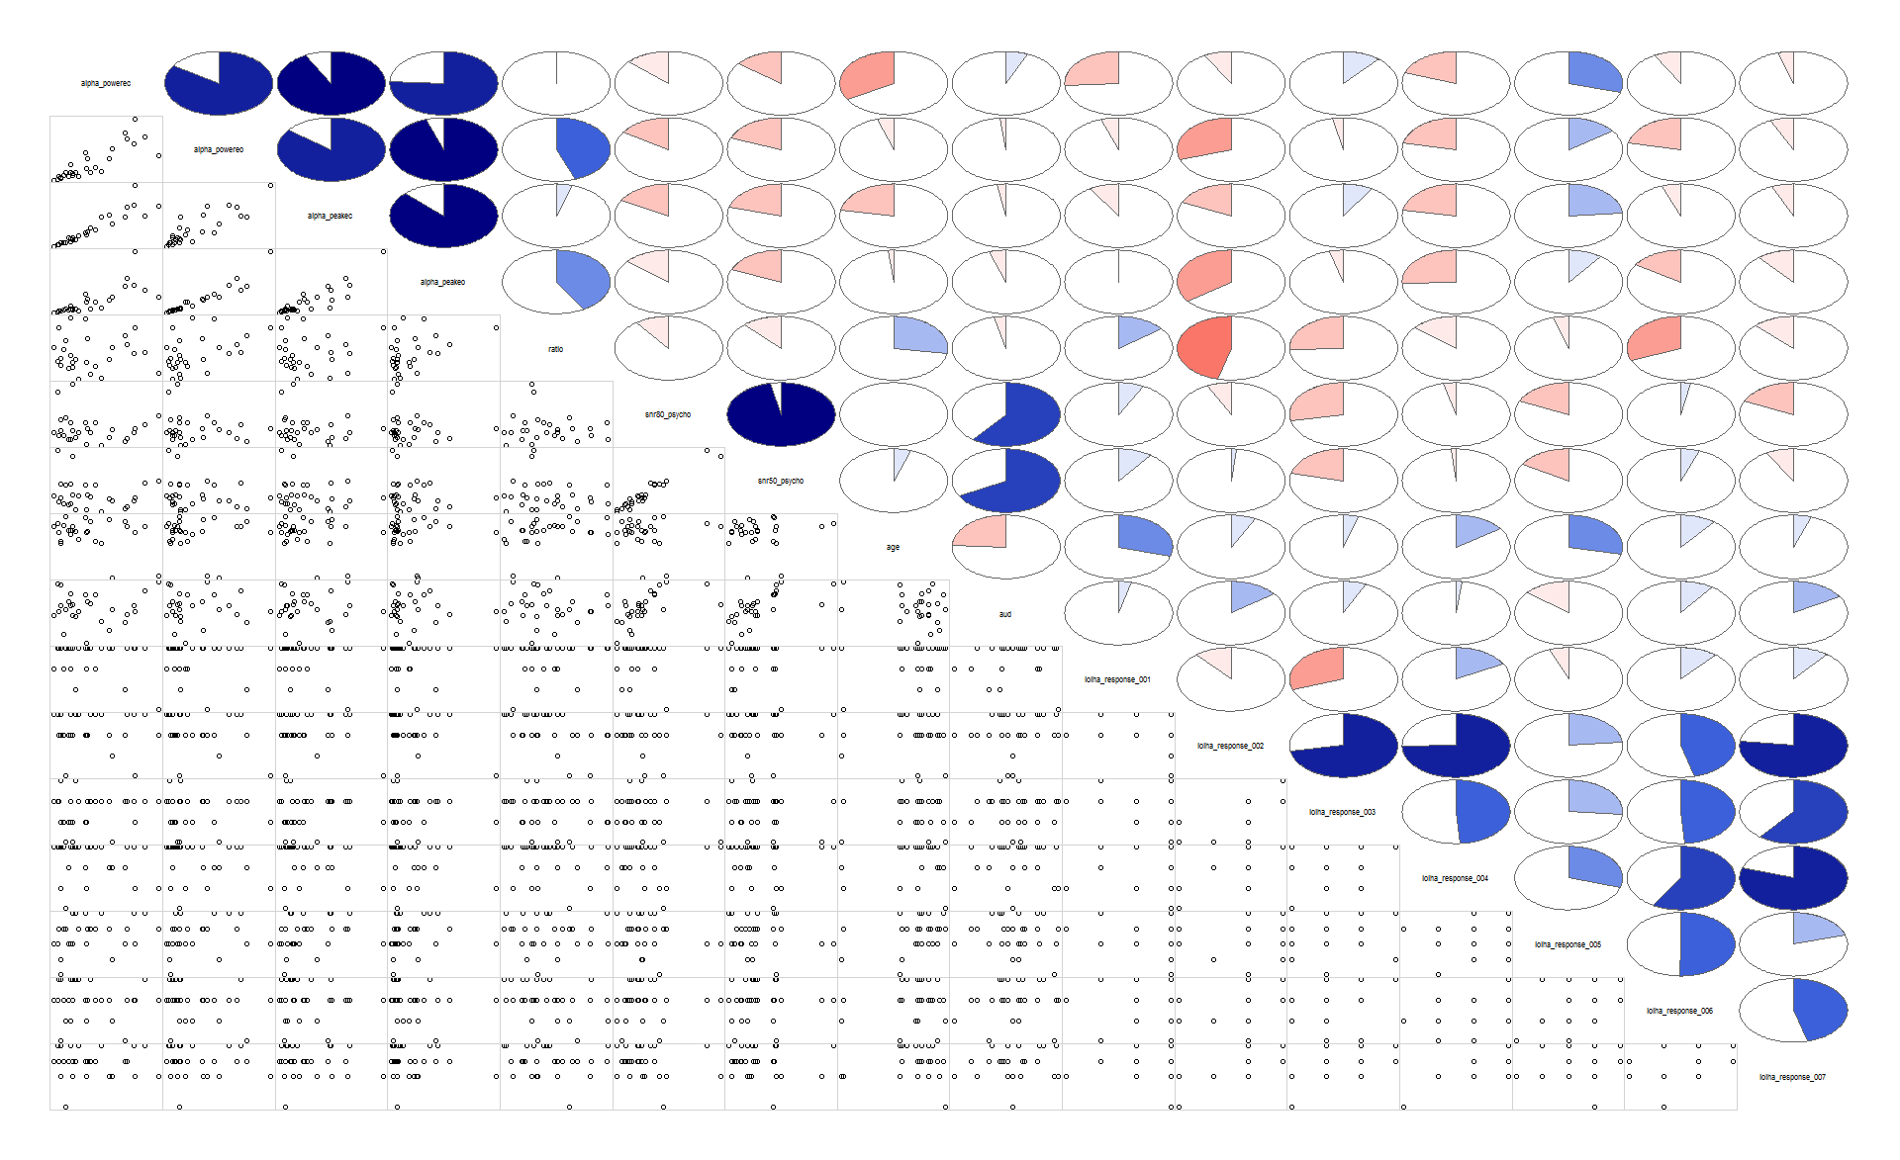
IOI: Individual Responses

Slide 9
lm (formula = alpha_powereo ~ ioiha_response_002 + ioiha_response_007, data = all_data)
Residuals:
Min 1Q Median 3Q Max
-4.0957 -2.9024 -0.2542 1.5060 11.0682
Coefficients:
Estimate Std. Error t value Pr(>|t|)
(Intercept) 8.8740 3.4672 2.559 0.0160 *
ioiha_response_002 -3.4627 1.1569 -2.993 0.0056 **
ioiha_response_007 2.4363 0.9405 2.590 0.0148 *
2) Think about the situation where you most wanted to hear better, before you got your present hearing aid(s).
Over the past two weeks, how much has the hearing aid helped in that situation?
6) Over the past two weeks, with you present hearing aids, how much do you think other people were bothered by
your hearing difficulties?
7) Considering everything, how much has your present hearing aid(s) changed your enjoyment of life?

Slide 10
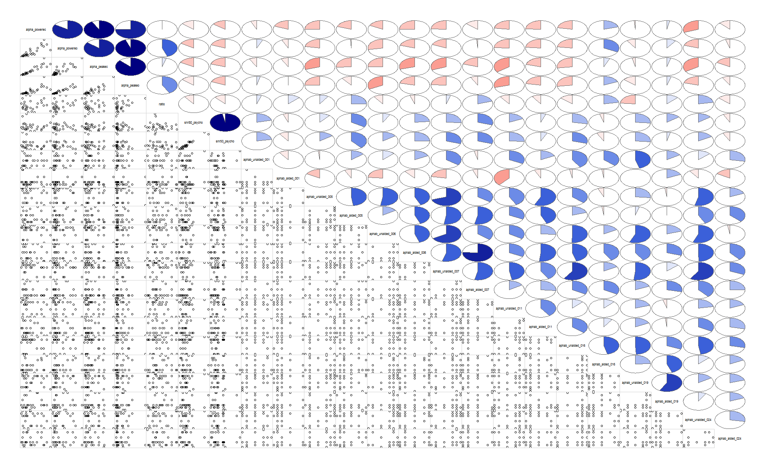

Slide 11
lm(formula = alpha_powereo ~ aphab_unaided_002 + aphab_unaided_003 + aphab_unaided_004 + aphab_unaided_005 + aphab_unaided_006 + aphab_unaided_007 + aphab_unaided_009 + aphab_unaided_012 + aphab_unaided_013 + aphab_unaided_014 + aphab_unaided_015 + aphab_unaided_016 + aphab_unaided_017 + aphab_unaided_018 + aphab_unaided_019 + aphab_unaided_022 + aphab_unaided_024, data = all_data)
Residuals:
Min 1Q Median 3Q Max
-2.9980 -1.4975 0.1528 1.0506 5.4164
Coefficients: Estimate Std. Error t value Pr(>|t|)
(Intercept) -8.41069 4.24679 -1.980 0.0790 .
aphab_unaided_002 0.16518 0.05711 2.893 0.0178 *
aphab_unaided_003 -0.14569 0.04558 -3.196 0.0109 *
aphab_unaided_004 -0.15721 0.06720 -2.339 0.0441 *
aphab_unaided_005 0.06731 0.03998 1.684 0.1266
aphab_unaided_006 -0.16425 0.07311 -2.247 0.0513 .
aphab_unaided_007 0.26213 0.10234 2.561 0.0306 *
aphab_unaided_009 -0.13849 0.04654 -2.976 0.0156 *
aphab_unaided_012 0.07379 0.03956 1.866 0.0950 .
aphab_unaided_013 0.38619 0.09652 4.001 0.0031 **
aphab_unaided_014 0.15421 0.06272 2.459 0.0362 *
aphab_unaided_015 -0.18425 0.06041 -3.050 0.0138 *
aphab_unaided_016 0.07412 0.04645 1.595 0.1451
aphab_unaided_017 0.11838 0.04308 2.748 0.0226 *
aphab_unaided_018 -0.22952 0.11744 -1.954 0.0824 .
aphab_unaided_019 0.08707 0.04803 1.813 0.1033
aphab_unaided_022 0.05607 0.02954 1.898 0.0902 .
aphab_unaided_024 0.07622 0.03801 2.005 0.0759 .
---
Signif. codes: 0 ‘***’ 0.001 ‘**’ 0.01 ‘*’ 0.05 ‘.’ 0.1 ‘ ’ 1
Residual standard error: 3.275 on 9 degrees of freedom
(6 observations deleted due to missingness) Multiple R-squared: 0.783, Adjusted R-squared: 0.3731 F-statistic: 1.91 on 17 and 9 DF, p-value: 0.1621
6) When I am listening to the news on the car radio, and family members are talking, I have trouble hearing the news.
16) I can understand conversations even when several people are talking (reversed)

Slide 12
Questions:
Measure alpha in ERP data?
ISI-2-2.5 seconds
300-400 msec alpha suppression
alpha suppression after syllable
2012 parametric variation Strauss, Neuroimage
Pz, change in alpha compared to baseline. 400-800 msec
Add noise, reduce alpha suppression.
Fieldtrip tutorial. Trials time frequency, intertrial phase coherence
Han taper window FT-frac analysis
Time frequency code

